Slide 1
ROS2 for Robots
Pankhuri Vanjani

Slide 2
Turtlebot Simulation in Navigation
2-D pose estimation (rviz)
2-D navigation goal
Turtlebot3 follows path and arrives at destination
If unexpected obstacle blocks the path
Robot can detect them to avoid

Slide 3
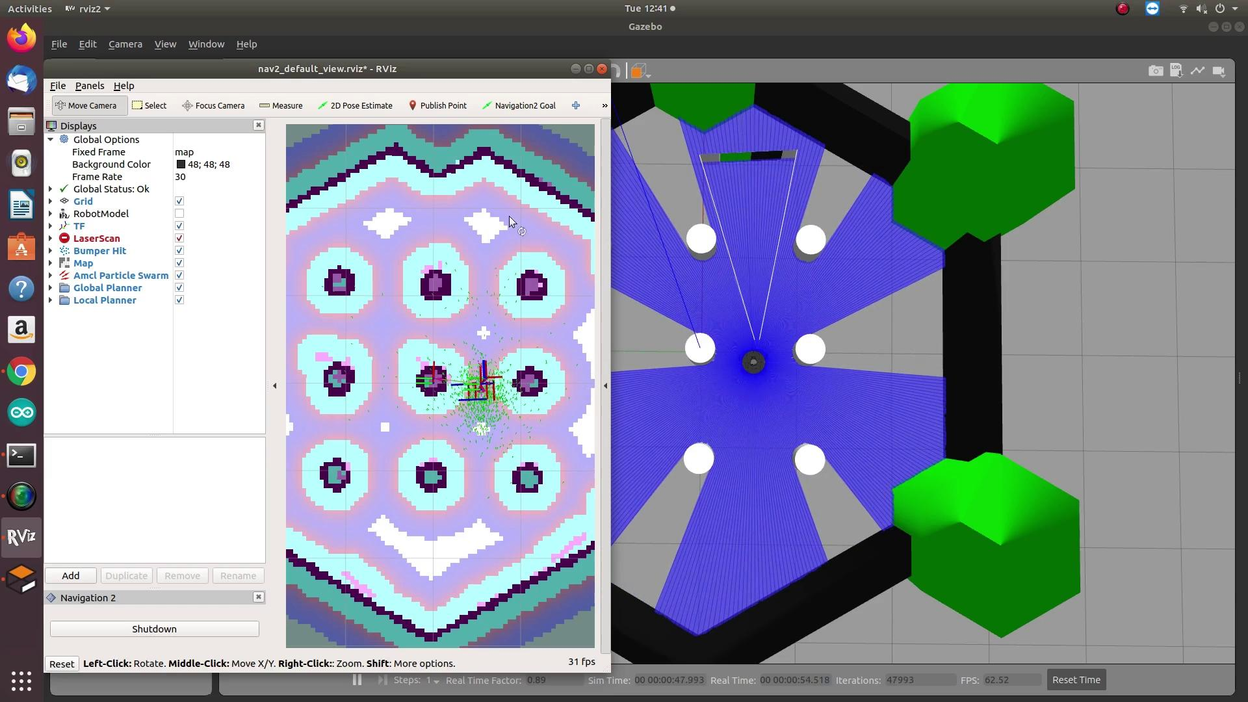
Turtlebot Simulation in Navigation

Slide 4
2. Turtlebot graphs and layers
Turtlebot3 uses:
Robot’s encoder
IMU sensor
Distance sensor
Saved map-> contains field info -> use in node

Slide 5
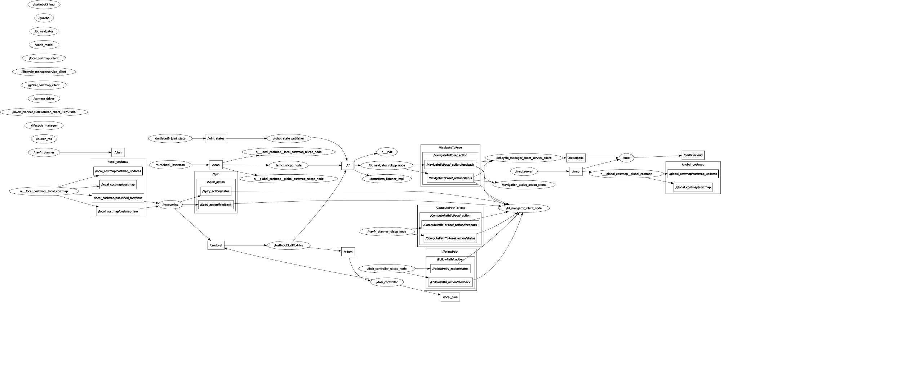

Slide 6
3. ROS2 Navigation stack
Navigation 2: send robot to a designated destination in a given environment
Uses data created in ROS2 SLAM
Control over params: max-min vel, rot. vel,accel, tolerance
Global Planner- global plan
Requires a map of the environment to calculate the best route
Local Planner
Transform global path -> suitable waypoints
Creates new waypoints -> dynamic obstacles; vehicle constraints
Use of navigation stack on an arbitrary robot
ROS required
TF transform tree (tf-maintains the relationship between coordinate frames in a tree structure buffered in time, and lets the user transform points, vectors, etc between any two coordinate frames at any desired point in time.)
Sensor data using correct ROS message type
Needs to be configured for shapes and dynamics of a robot to perform at a high level
Planar laser mounted somewhere on the mobile base (map building and localization); docs.

Slide 7
4. Orca 2 Simulation

Slide 8
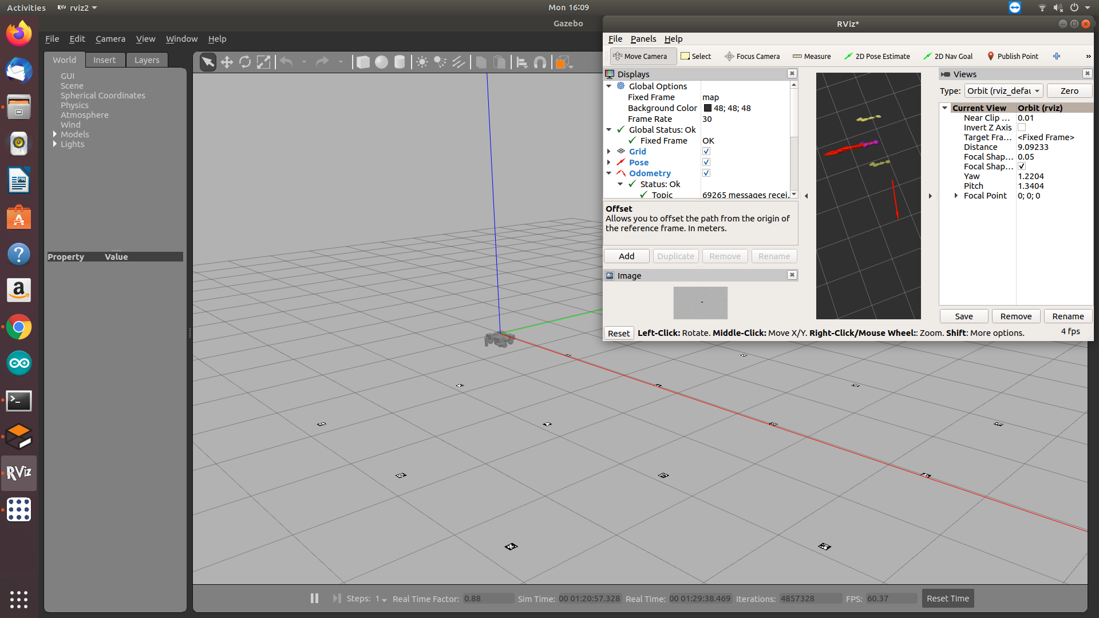

Slide 9
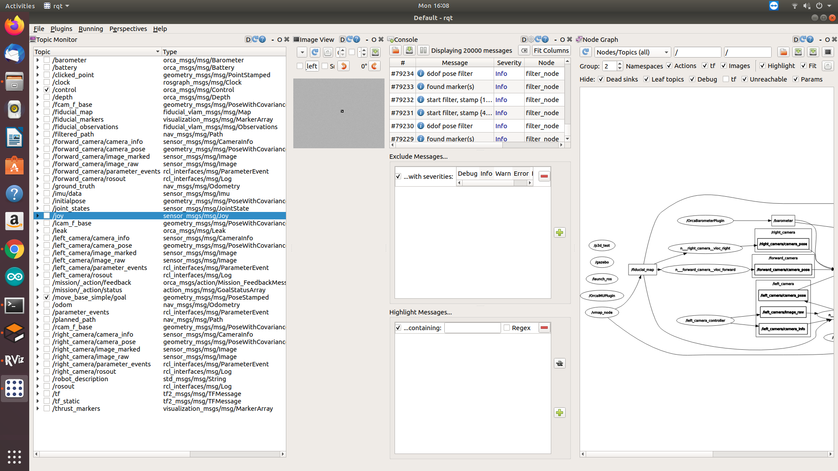
RQT

Slide 10
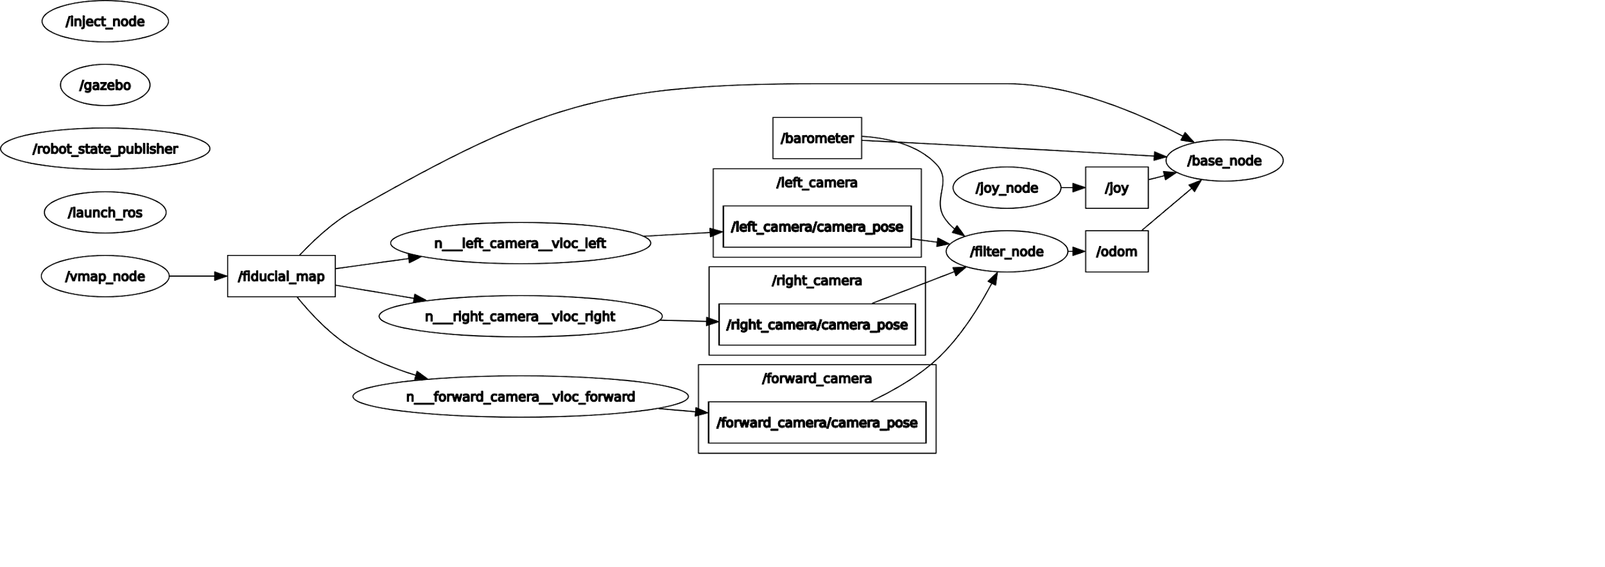
Ros2 graph of current Orca implementation

Slide 11
5. ORCA2 Drivers and layers
Orca_msgs :
Can set mission goals in rviz
Support mission actions
msg/Barometer.msg
msg/Battery.msg
msg/Control.msg
msg/Depth.msg
msg/Efforts.msg
msg/Leak.msg
msg/Proc.msg
msg/Pose.msg
msg/PoseStamped.msg

Slide 12
5. ORCA2 Drivers and layers
Orca_description :
URDF file provided for Orca2
Orca_base (Orca control loop)
PID controllers
High-level controllers: calculate the pose error and pass it to the 4 PID controllers.
Trajectory planner and feedforward
Pololu Maestro : send PWM messages to the ESCs
Forces modelled : gravity, buoyancy, thruster translation forces, vehicle drag
Modes: disarmed, manually controlled thrusters, hold in z position(PID ), Mission AUV
VSLAM, a* path planning

Slide 13
5. ORCA2 Drivers and layers
Orca_drivers (for hardware interface)
Rpi, USB camera
Barometer
depth
Maestro
Mraa
Joystick-teleoperation
Leak sensor

Slide 14
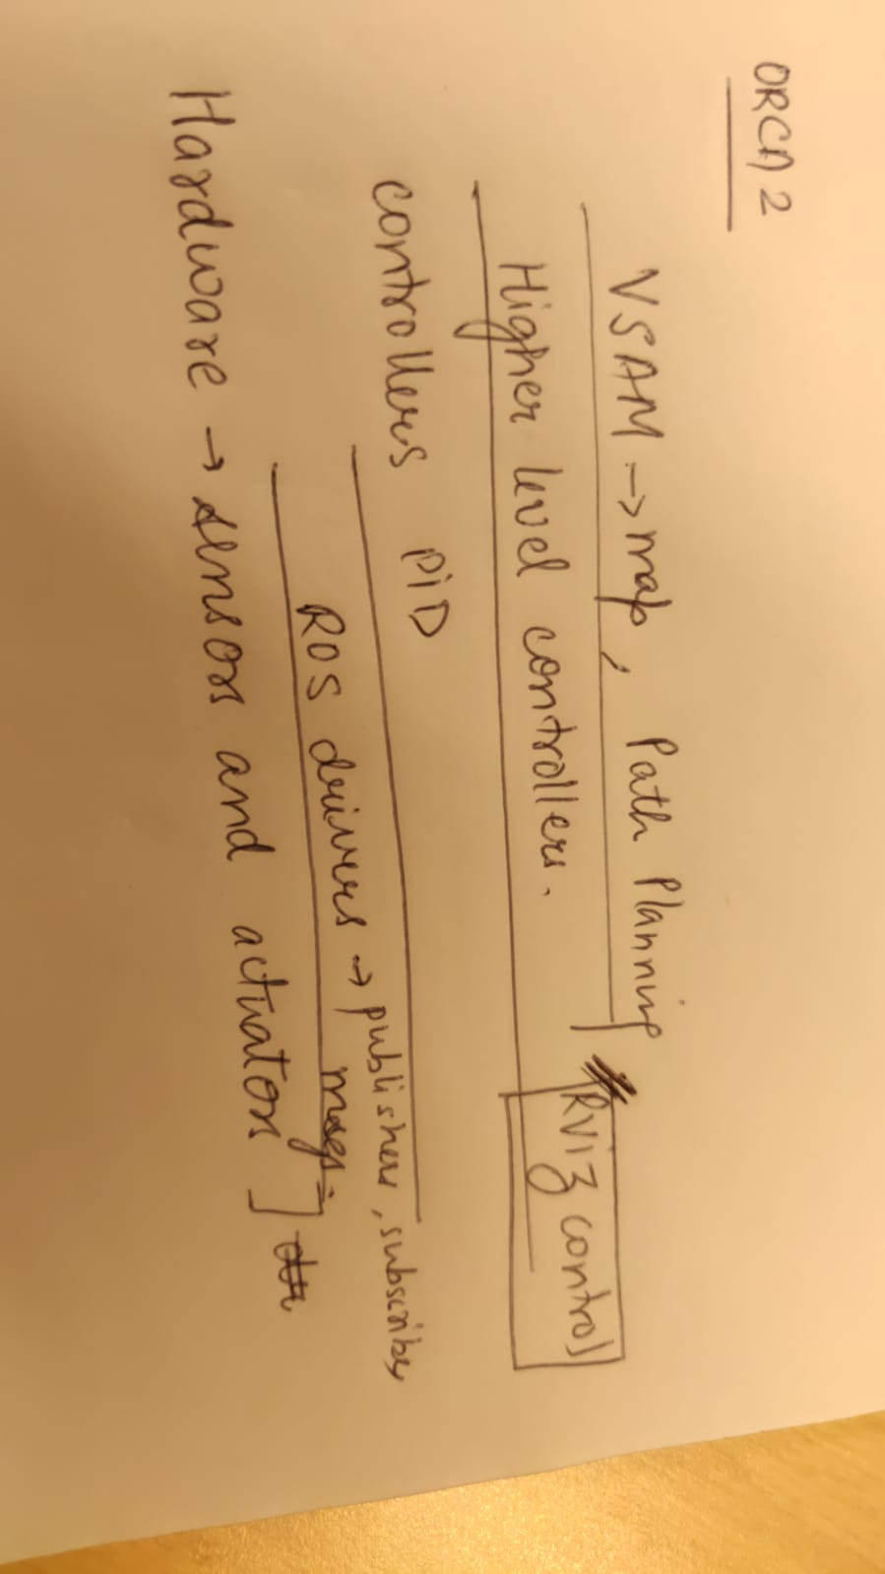
Orca2 Layers

Slide 15
Suggestions for Rosification with BlueROV (from ORCA developers)
3 ways to ROSify a BlueROV2:
Use the existing hardware (Pixhawk) and software (ArduSub), and use mavros to move messages from the MAV message bus to/from ROS. See BlueRov-ROS-playground for a good example of this method. This is the fastest way to integrate ROS with the BlueROV2.
Port ROS to the Pixhawk and NuttX, and run a ROS-native driver on the Pixhawk.
Provide a ROS-native driver running on Linux, such as the Raspberry Pi 3. You'll need to provide a small device controller, such as the Pololu Maestro, and an IMU, such as the Phidgets IMU. This is the Orca design.

Slide 16
Navigation stack for other underwater Robots? (if time permits)

